Slide 1
ActiveMesh
ACE Solutions Architecture Team

Slide 2
Overview

Slide 3

What is it ?
Provides network resiliency, improved convergence time and high performance
Two Aviatrix gateways in a VPC/VNet/VCN form a cluster
Both gateways forward traffic simultaneously via ECMP
Each gateway in a Spoke VPC/VNet/VCN builds IPsec tunnels to both Transit gateways
Number of Transit and Spoke gateways as well as their instance sizes are independent of each other:
Maximum 2x Transit Gateways can be deployed per Transit VPC/VNet/VCN
Maximum 15x Spoke Gateways can be deployed per Spoke VPC/VNet/VCN
Spoke-1
Spoke-2
Transit
FireNet

Slide 4

Use Cases
Intra-Region Spoke-Spoke
Cloud to On-Prem
Inter-Region / Multi-Cloud
Region-1
Region-1
Spoke-1
Spoke-2
Transit
FireNet
Region-1
Region-2
DX/ER/Internet
Transit
Transit
Transit
FireNet
ON-PREM

Slide 5
Resiliency

Slide 6

Failover Scenario 1
Workload
Workload in Spoke-1 VPC/VNet traverses Primary gateway, Tunnel 1, onto Transit to Spoke-2 VPC/VNet (not shown)
If Tunnel 1 at the First Spoke Gateway fails,
Then, the traffic uses Tunnel 2, connected to the SecondTransit Gateway
This tunnel was already active and was forwarding half of the traffic (same metric 100)
No re-convergence of the routes in the VPC/VNet route table
Gateway handles the change on its own
Controller is aware of the tunnel going down event, but it is not involved in making the change
Spoke-1 VPC/VNet
First
Gateway
Second
Gateway
Tunnel 2
Tunnel 1
Transit VPC/VNet

Slide 7
Failover Scenario 2
Workload
Workload in Spoke-1 VPC/VNet traverses Primary gateway, Tunnel 2, onto Transit to Spoke-2 VPC/VNet (not shown)
If both Spoke ←→ Transit tunnels fail on Primary Spoke gateway:
The traffic gets forwarded from the Primary Spoke gateway through the interconnected link to the Secondary Spoke Gateway
Secondary Spoke Gateway forwards the traffic to any of the Transit Gateways via ECMP (usual behavior – metric 100 on both downstream links)
No re-convergence of the routes in the VPC/VNet route table
Gateway handles the change on its own
Controller is aware of the tunnel going down event, but it is not involved in making the change
Spoke-1 VPC/VNet
First
Gateway
Second
Gateway
Tunnel 2
Tunnel 1
Transit VPC/VNet

Slide 8
Failover Scenario 3
AZ-A route table RT-A
Initially: 10.0.0.0/8 → Spoke-AZ-A-GW NIC After failover: 10.0.0.0/8 → Spoke-AZ-B-GW NIC
AZ-B route table RT-B 10.0.0.0/8 → Spoke-AZ-B-GW NIC
Workload
The workload in Spoke-1 VPC/VNet needs to reach Spoke-2 VPC/VNet (not shown), but the Gateway is down.
If the First Gateways fails, the Controller will detect this event through the periodic keepalive messages exchanged between itself and the gateways.
In this scenario, the Controller will reprogram the routing table in the AZ-A, updating the next hop of the three RFC1918 routes with the ENI of the Second Spoke Gateway, in AZ-B
Spoke-1 VPC/VNet
First Gateway
Second Gateway
AZ-B
AZ-A
Tunnel 2
Tunnel 1
Transit VPC/VNet
8

Slide 9
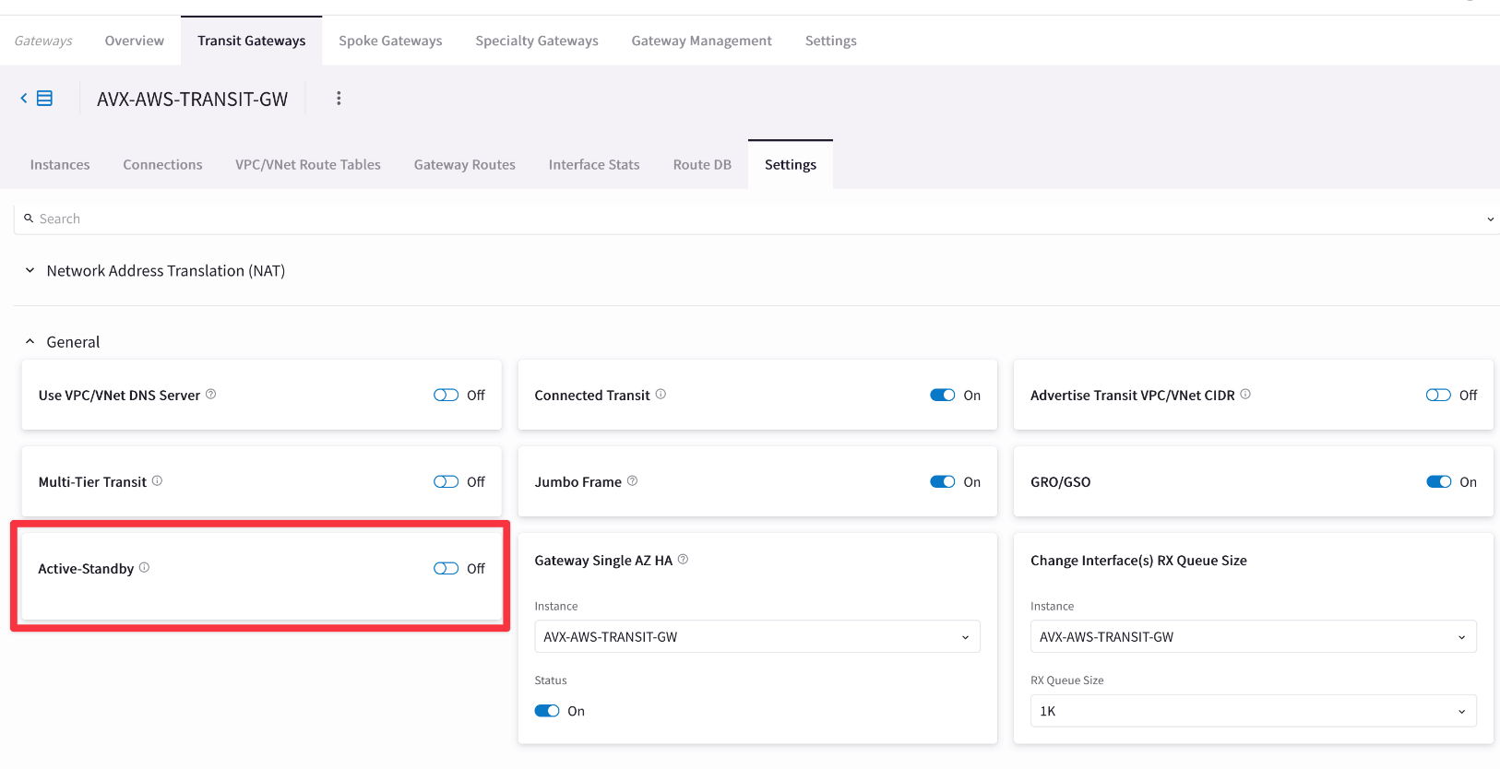
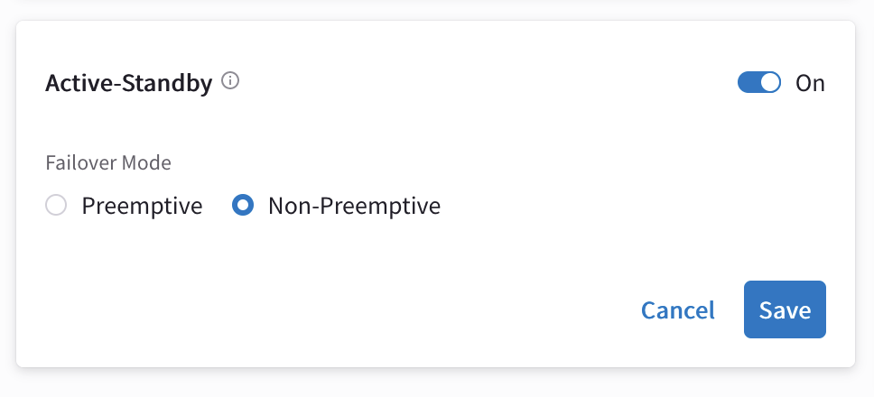
Active-Standby Mode (introduced in Controller version 6.6)
Use case: Deployment scenario where an on-prem device such as a firewall does not support asymmetric routing on two tunnels
Upon failure, the Second gateway takes over from the First gateway
The first does not become active unless there is a manual switchover or the Second fails
UI provides an option for customers to choose Preemptive or Non-preemptive behavior.
Default

Slide 10
Aviatrix Control Plane
Deterministic Routing

Slide 11




Route Programming: Software-Defined (SD) / Static / Dynamic
SD
SD
SD
VPC
VPC
VPC
VPC
VPC
VPC
VNet
SD
VPC
VPC
SD
SD
SD
Transit
VPC
SD
Transit
VNet
SD
Transit
VPC
SD
FireNet
DXGW
BGP
SD
STATIC
BGP
SD
STATIC
BGP
BGP
Cloud Interconnect
DX
BGP
ON-PREM
DATA CENTER
ON-PREM
DATA CENTER

Slide 12
Route Classification
AWS TGW Attachment [L]
Aviatrix Spokes (VPC/VNet) [L]
Azure Native Spokes [L]
Aviatrix Transit GW – on-prem (static) [L]
Firewall Egress 0/0 [L]
Transit VPC/VNet associated prefixes [L]
Transit GW SNAT IP [L]
Remote Transit GW (Transit Peering) [B]
TGW DXGW [B]
TGW VPN [B]
Site2Cloud BGP on Transit GW (including Edge routes) and Site2Cloud BGP on Spoke GW [B]
L = Routes considered local by Controller
B= BGP learned routes
VPC
VPC
VPC
VPC
VNet
VNet
VPC
VPC
VPC
L
L
L
L
L
Transit
VPC
Transit
VNet
L
Transit
VPC
L
FireNet
B
FireNet
B
SNAT
L
L
B
B
10
DXGW
L
L
11
B
11
Cloud Interconnect
ON-PREM
DATA CENTER

Slide 13
Path Selection Algorithm for Deterministic Next-Hop Selection
L = Routes considered local by Controller
B= BGP learned routes
Route Selection Algorithm
Longest prefix match
If equal length, then local route is chosen
If routes are of the same type, then shortest AS-path length is chosen
If AS-path length is the same, then lowest metric is chosen
If metric is the same, then
If ECMP is enabled, then traffic is distributed to available routes
If ECMP disabled, then the route first programmed in the table is chosen
If programmed at the same time, then lower integer IP next hop is chosen
VPC
VPC
VPC
VPC
VNet
VNet
VPC
VPC
VPC
L
L
L
L
L
Transit
VPC
Transit
VNet
L
Transit
VPC
L
FireNet
B
FireNet
B
SNAT
L
L
B
B
10
DXGW
L
L
11
B
11
Cloud Interconnect
ON-PREM
DATA CENTER

Slide 14

Example of using Transit as an alternate path 1/3
At steady state
Each transit is learning 10/8 locally from on-prem
For each transit, Controller DB will have 10/8 via local and peer transit
Route via peer will have as-path-len 2
Each transit and its spokes will get to on-prem via local private path (DX/ER) as best path
Spoke-1
Spoke-2
Spoke-1
Spoke-2
Best Route for 10.0.0/8
Best Route for 10.0.0/8
ASN: 65010
ASN: 65020
Transit
Transit
10.0.0.0/8
10.0.0.0/8
Express Route
Direct Connect
ASN: 65000
MPLS
ASN: 65001
SFO-ON-PREM
ORG-ON-PREM

Slide 15
Example of using Transit as an alternate path 2/3
Spoke-1
Spoke-2
Spoke-1
Spoke-2
When on-prem connection goes down
For e.g., DX is down
Only route to 10/8 now is via Azure Transit
Best Route for 10.0.0.0/8
Best Route for 10.0.0/8
ASN: 65010
ASN: 65020
Transit
Transit
10.0.0.0/8
10.0.0.0/8
Express Route
Direct Connect
ASN: 65000
MPLS
ASN: 65001
SFO-ON-PREM
ORG-ON-PREM

Slide 16
Example of using Transit as an alternate path 3/3
Use AS-PATH Prepend
E.g, SFO on-prem ER is going under planned maintenance
You want to avoid sending any traffic through SFO on-prem ER
You can send AS-paths from SFO on-prem so that AWS Transit becomes the preferred path
Spoke-1
Spoke-2
Spoke-1
Spoke-2
Best Route for 10.0.0.0/8
ASN: 65010
ASN: 65020
Transit
Transit
10.0.0.0/8
10.0.0.0/8
Express Route
Direct Connect
AS-Path Prepend: 65000 65000 65000
MPLS
ASN: 65001
SFO-ON-PREM
ORG-ON-PREM

Slide 17
Next: Lab 5 – HPE with ActiveMesh

